Slide 1
MHST Young People’s Working Group
Slough MHST Schools Cluster Meeting 22nd June 2022

Slide 2
‘We were able to have a joint conversation with another school about mental health, and brainstorm ideas and learn about what they are doing in their school, which works well. The main trends that were identified were stress and anxiety felt by students in both schools. It highlighted to me, that although we are separate schools, in different areas of Slough, students are experiencing similar problems. I hope having this team in our school, can help to open avenues of conversations with students and parents’
Student from Lynch Hill Enterprise Academy

Slide 3
Timeline
MHST Host School set-up meetings – March 2022
Wexham and Lynch Hill YP’s Working Group – April 2022
Claycots and Grove Academy YP’s Working Group – May 2022
Follow up discussion between EMHP and SMHL - May/June 2022
Actions to carry forward – end of summer term/new academic year

Slide 4
Working Group Discussion Themes
Access and Engagement
Common Mental Health Presentations
Barriers to Accessing Support

Slide 5
Access and Engagement
Assemblies, school newsletter, posters, book displays
Smaller tutor group sessions or within PSHE lessons
School events, e.g. enrichment days, parent evenings
School Captains/MH champions/Student Council

Slide 6
Common Difficulties and Mental Health Presentations
Peer relationships
Transition to secondary school
Exam stress
Low mood
Anxiety
Loneliness
Readjusting after pandemic
Behavioural

Slide 7
Barriers to Accessing Support
Mental health knowledge
Lack of awareness of safeguarding team/pastoral support
Mental health stigma
Cultural barriers

Slide 8
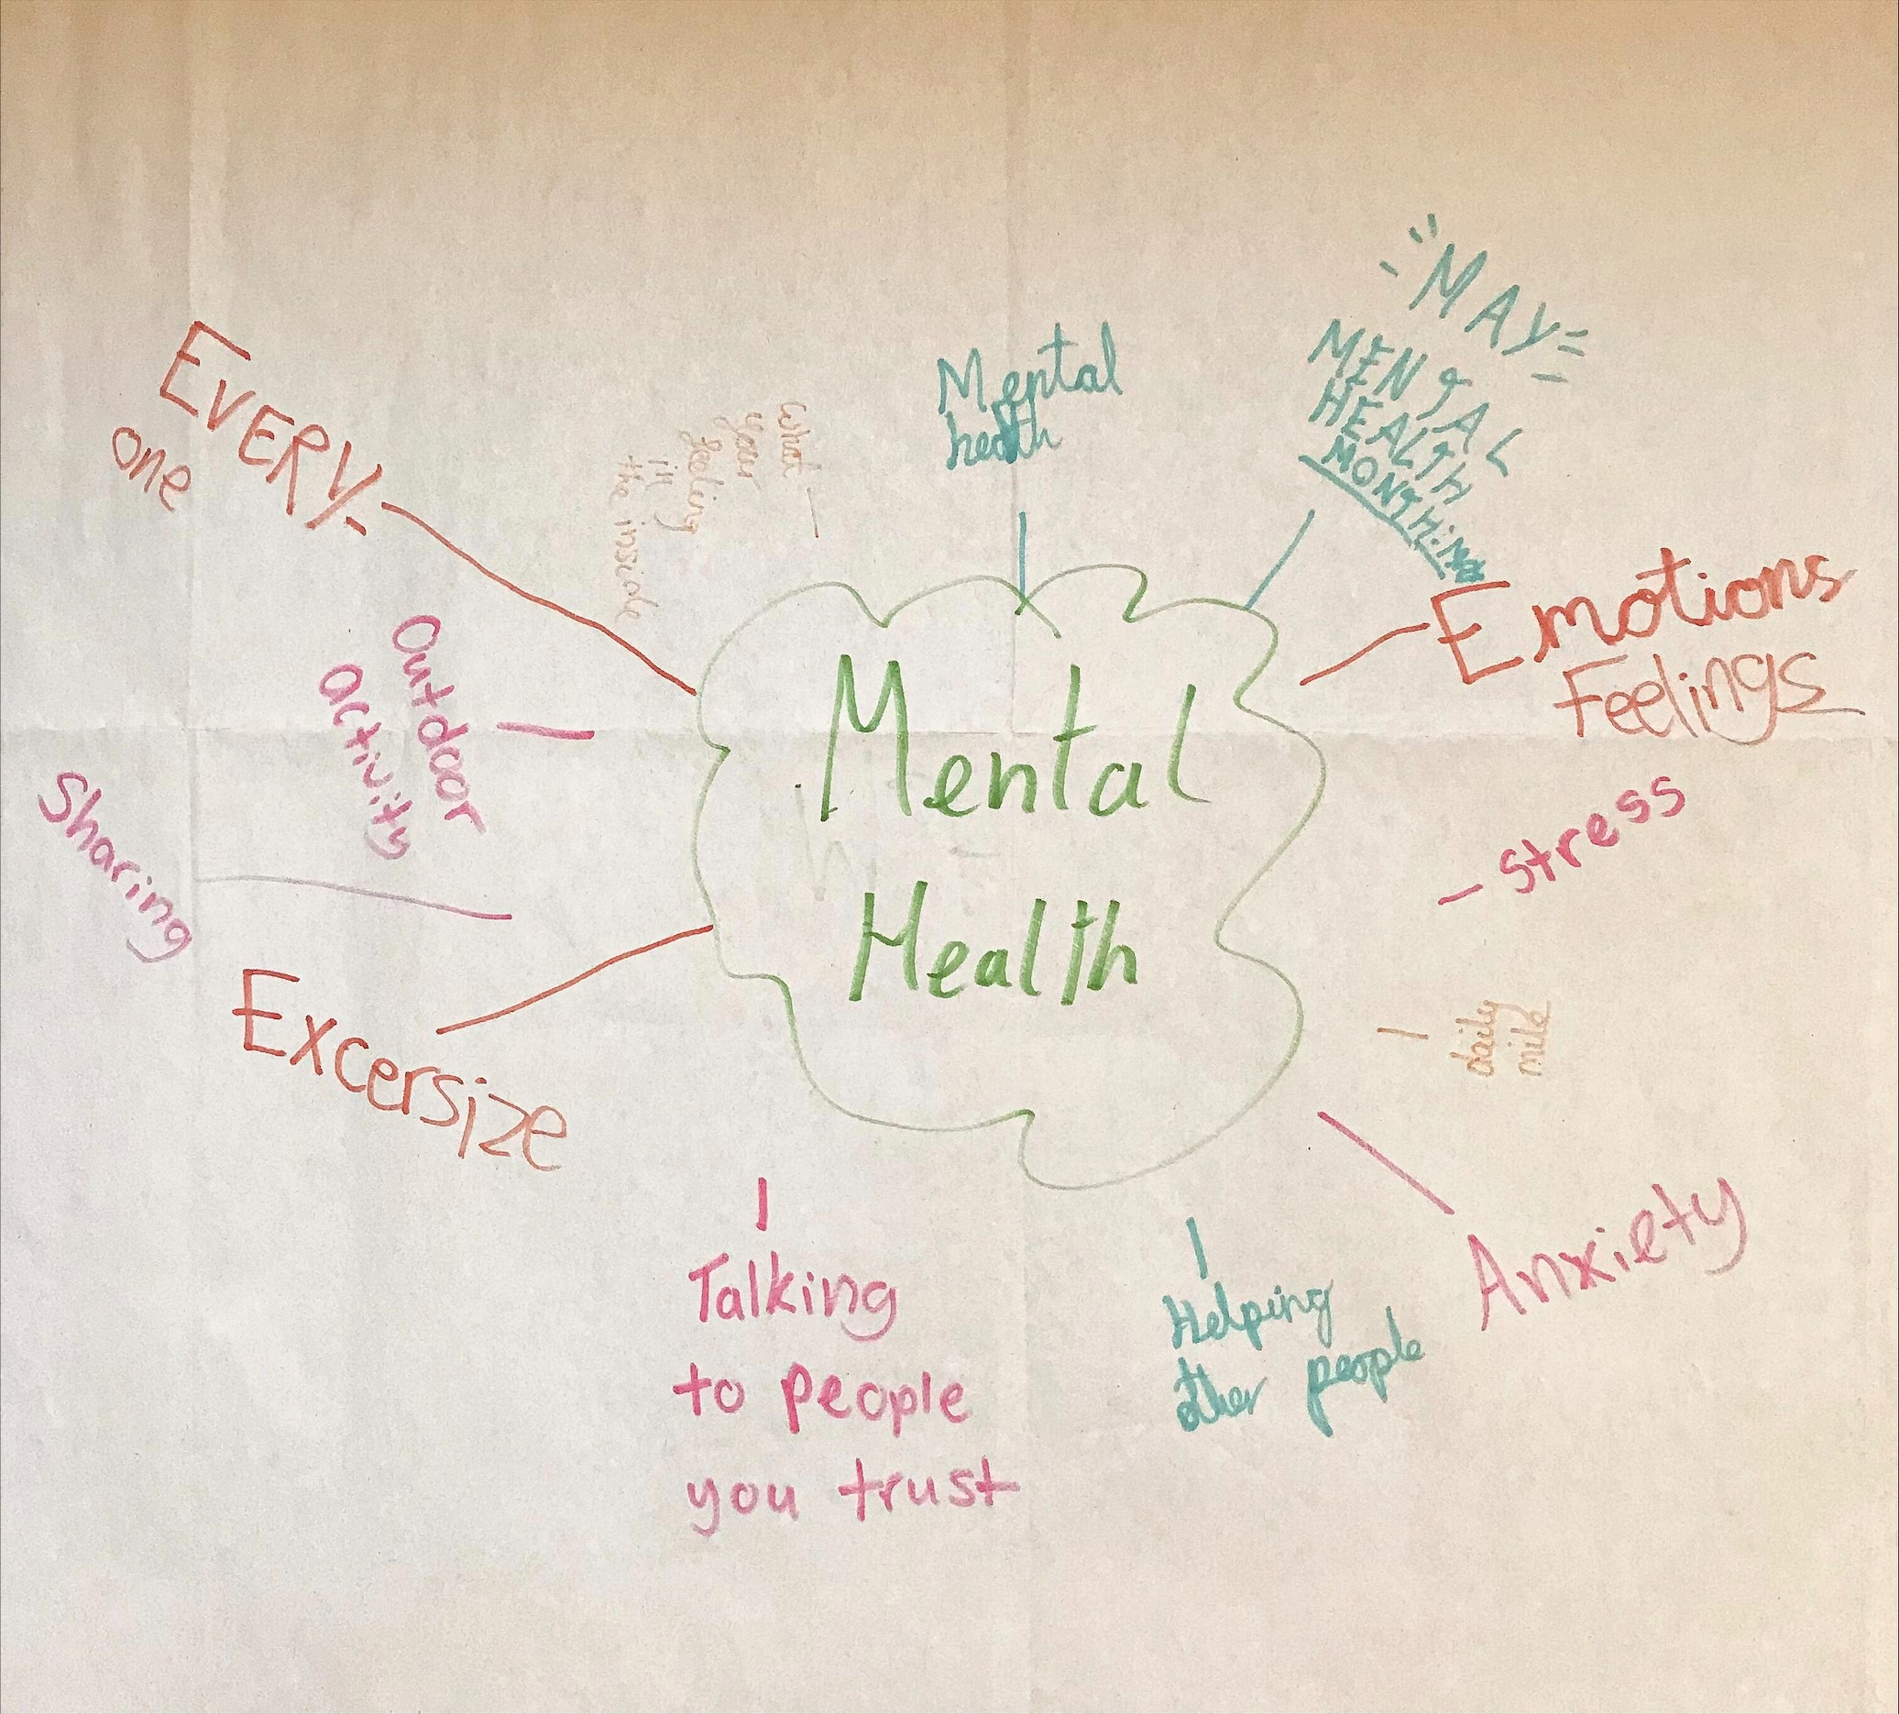
MHST: Whole School Approach
1.Leadership & Management
2.Ethos & Environment
3.Curriculum
4.Student Voice
5.Staff Development
6.Auditing & Monitoring
7.Parents & Carers
8.Targeted Support
Claycots Primary School

Slide 9
What we have done so far…
What next?
MHST overview presentations
Surveys
Student Assemblies
School Newsletter
Staff and student workshops
Parent events
Staff consultations
Pastoral flowchart development
Peer mentoring

Slide 10
“It was good to communicate and speak about raising awareness about mental health. It was reassuring to know that people are aware about the stigma surrounding mental health in schools amongst young children. The Mental health team were very supportive.”
Wexham School Student
“I think the team will really help our school.” Claycots Primary Student
“I think it was quite an interesting session. We learnt about each other’s schools and how Wexham dealt with issues which was quite inspirational. The discussions with the mental health practitioners allowed us to highlight some things going on at school and share ideas on how they could be dealt with. Overall it was quite enjoyable and I will be looking forward to the next session.”
Lynch Hill Enterprise Academy Student
“We felt very comfortable speaking to the MH team, at the meeting. It was helpful to get an insight of how other schools are dealing with issues of mental health and what support systems they have put in place compared to Wexham” Wexham School Student
“It was really good that we got talk about people’s feelings and how we can help.”
Claycots Primary Student

