Slide 1

Understanding Dementia Course
Supporting physical wellbeing
Managing Continence
Disturbed nights

Slide 2
Continence & dementia
Many people with dementia do not become incontinent, or only experience problems with continence when their illness is quite advanced, but in some types of dementia incontinence can feature earlier
There can be many reasons (unrelated to dementia) why a person may begin to experience problems with continence
It is important not to miss these and simply put continence problems down to dementia

Slide 3
Medical reasons for incontinence
(incidence increases with age)
Urinary tract infections
Prostate gland problems – common in older men
Pre-existing bowel conditions such as irritable bowel syndrome (IBS)
Side effects of medication
Constipation – what might appear to be faecal incontinence might in fact be liquid faeces slipping around a hard impacted stool.

Slide 4
Urinary Tract infections - are people with dementia at increased risk?
A weakened immune system
Reduced hygiene and / or incontinence
Dehydration from not drinking enough
Any acute infection (commonly a urine or a chest infection) can cause an acute confusional state (delirium)
This can be mistaken for a worsening of the dementia – whereas if recognised and treated can improve quickly

Slide 5
How to recognise delirium
Experts have identified three types of delirium.
Hyperactive delirium -probably the most easily recognized type, this may include restlessness (for example, pacing), agitation, rapid mood changes or hallucinations, and refusal to cooperate with care
Hypoactive delirium this may include inactivity sluggishness, abnormal drowsiness, or seeming to be in a daze
Mixed delirium this includes both hyperactive and hypoactive signs and symptoms. The person may quickly switch back and forth from hyperactive to hypoactive states.

Slide 6
Incontinence related specifically to dementia
Damage to nerve pathways in the brain that are involved in bladder and bowel control
Not being able to communicate that you need the toilet
Forgetting that you need the toilet until it’s too late
Mobility problems (related to dementia or to other health problems) which mean you can’t get to the toilet in time, or have difficulty undoing clothing or getting onto the toilet
Struggling to recognise or remember where the toilet is

Slide 7
Some tips to help support continence
Being able to communicate a need for the toilet or to ask for assistance in good time
Be aware and alert to the signs
Remembering and recognizing the need to go
Regular reminders – try to establish a routine
Accidents as a result of mobility and balance problems
Suitability of clothing / raised toilet seat / grab rails
Recognizing or knowing where to find the toilet in unfamiliar places (or even at home)
Signs or picture on door / contrast door colour & toilet seat / leave door open / light on at night/ motion sensor
Notes:
ROLE PLAY
Volunteer to use commode with long skirt or baggy trousers / pad & net knickers / need to keep one hand on frame at all times / SKIRT GETS WET IN PROCESS – IS THIS INCONTINENCE?

Slide 8
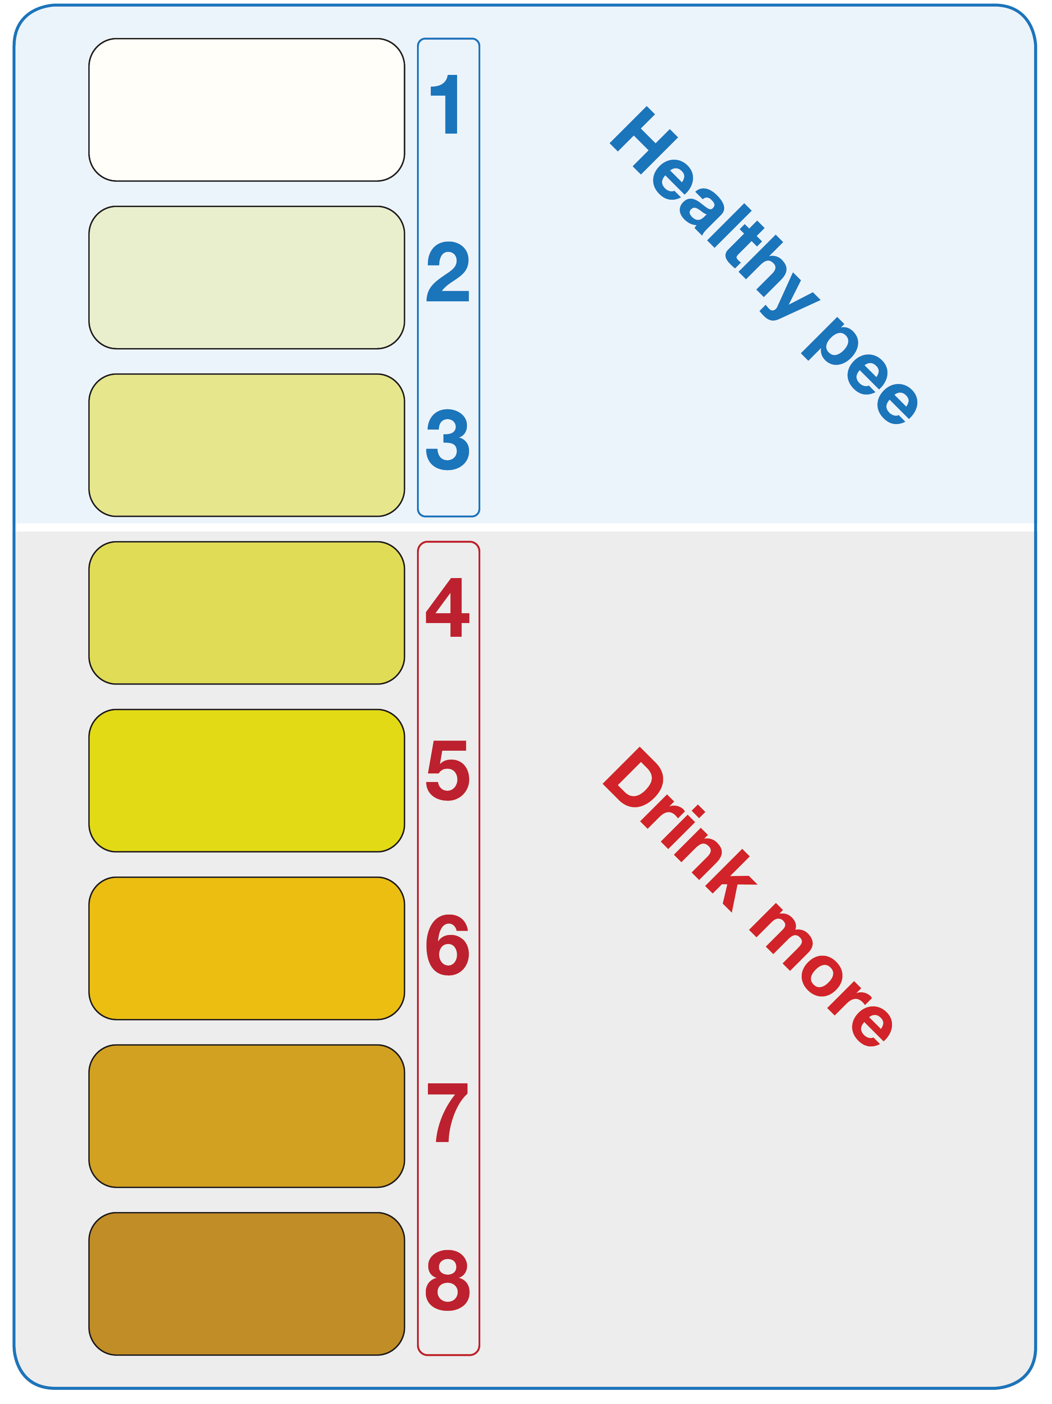
Are you drinking enough?
Source
NHS Inform website
www.nhsinform.scot/campaigns/hydration

Slide 9

How much should we be drinking?
44 kg (7 stone) – 1 ½ litres (approx. 2 ½ pints)
50 kg (8 stone) – 1 ¾ litres (approx. 3 pints)
57 kg (9 stone) – 2 litres (approx. 3 ½ pints)
63 kg (10 stone) – 2 ¼ litres (approx. 4 pints)
Notes:
Someone weighing 7 stones needs to drink 1 ½ litres
8 – 1 ¾ litres
9 – 2 litres
10 – 2 ¼ litres

Slide 10
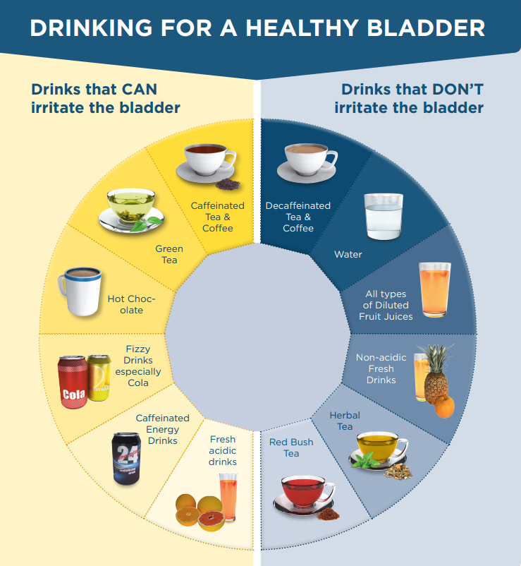
Source
NHS Isle of Wight
www.iow.nhs.uk/

Slide 11
Importance of maintaining faecal continence
Support mobility and encourage physical activity
Encourage fibre intake (in combination with fluids)
Natural products such as prune juice and golden linseed can be helpful
Some laxatives work by softening the stools and others also stimulate the bowel
Take medical advice -overuse of certain laxatives can lead to dependency and decreased bowel function

Slide 12
Access to locked toilets
Radar key – gives access to toilets for the disabled – often found alongside public toilets but often locked
Order a radar key (cost of £4.49 inc. P&P) along with a guide to the national key scheme
Call 01395 222588
Website www.radarkey.org
Website and phone apps with information about Changing Places Toilets – including each one's facilities, opening hours and how to get there–Website www.loo.org

Slide 13
Just can’t wait card
Assists with access to your closest toilet
Helps explain and avoid potentially embarrassing situations quickly
Universally recognised symbols
Free of charge for online orders or fill out application form
Also available as a phone app which includes a map to find your nearest toilet
Call general enquiries 01926 357 220
Email help@bladderandbowel.org
Website www.bladderandbowel.org/help-information/just-cant-wait-card/

Slide 14
Continence Aids
If incontinence cannot be avoided
your District Nurse
or
Continence Advisor
can help you obtain suitable aids and services
Notes:
INCLUDING:
SUITABLE PADS AND PANTS
ABSORBENT COVERS FOR CHAIRS
WATERPROOF COVERS FOR MATTRESSES / PILLOWS
ABSORBENT BED PADS TO PROTECT BEDDING
LAUNDRY SERVICE

Slide 15
Potential sleep problems associated with dementia
Sleeping during the day so not tired at night
Try to establish a routine of activity during the day e.g. clubs / day centres / a daily walk
Uncomfortable at night
e.g. too hot / too cold / in pain
Too many or not enough blankets / Room temperature etc.
Might regular pain relief help?

Slide 16
Disturbed nights may relate to
Mixing up day and night
Dark winter evenings - close curtains and control lighting using daylight bulbs and a dimmer switch / Light summer nights & mornings – use of black out curtains
Mixing the real and the imaginary
Avoid disturbing TV stories prior to bedtime – aim for relaxing wind-down bed-time routines
Anxiety as a result of disorientation and the associated rush of adrenalin(where am I? / who are you?)
Logical reasoning when a person wakes at night often doesn’t help.
Try strategies e.g. responding to feelings rather than facts / reassurance / distraction

Slide 17
10 Tips to beat insomnia
Keep regular sleep hours
Create a restful sleeping environment
Make sure your bed is comfortable
Exercise regularly
Cut down on caffeine
Do not over-indulge
Do not smoke
Try to relax before going to bed
Write away your worries
If you cannot sleep, get up

Slide 18
Your Need for Sleep
Make the environment safe
Let the person get up and potter while you sleep
Technology to help you relax (lights / alarms etc.)
Other ideas:
Night sitters
Respite care breaks
Informal help from other family members (nights off to recoup)
Medication?
Notes:
Sitting and respite to be discussed in session 6
Pressure mat sensors
Nightlights
Baby alarms

Slide 19
Thank you
Final questions and comments…
Further information can be found in the information pack accompanying this session

